Slide 1

ONLINE BOOKSTORE MANAGEMENT SYSTEM
PROJECT GUIDE :
Dr. K Jayasakthi Velmurugan
Assist Prof. (SG), Dept. of Industrial Eng.,
Institute of Mechanical Eng.,
SSE, SIMATS
P.K.GOKULAVASAN-192211892
SSE, SIMATS

Slide 2
S.No | Content
1 | Abstract
2 | Introduction
3 | Objective
4 | Literature review
5 | Flow chart
6 | Methodology
7 | Program design
8 | Implementation
9 | Results
10 | Conclusion
11 | Future works
12 | References
Agenda

Slide 3
OBJECTIVES OF YOUR PROJECT
User-Friendly Interface: To develop an intuitive online bookstore platform that simplifies the process of browsing and purchasing books for customers.
Efficient Admin Management: To create an admin interface that allows effective management of book inventory and order processing.
Cloud Integration: To leverage AWS services for secure user authentication, scalable database management, and efficient cloud storage solutions.
Enhanced Shopping Experience: To implement features such as a shopping cart, payment gateway, and order tracking to improve customer satisfaction.
Automated Notifications: To provide timely email notifications to customers regarding order confirmations and shipment tracking.

Slide 4
EXISTING SYSTEM AND ITS DRAWBACKS
Limited Accessibility: Traditional bookstores require physical visits, restricting customer access and convenience.
Manual Inventory Management: Current systems rely on manual tracking, leading to potential errors and inefficiencies in stock management.
Lack of Online Payment Options: Many existing systems do not support online transactions, reducing customer trust and convenience.
Inadequate Reporting Tools: Insufficient analytics tools make it difficult for admins to assess sales performance and inventory status.
Complex User Interfaces: Non-intuitive designs can discourage potential customers from using the system effectively.

Slide 5
PROPOSED SYSTEM AND ITS ADVANTAGES
24/7 Online Access: Customers can browse and purchase books anytime, enhancing convenience and reach.
Intuitive User Interface: A user-friendly design allows for easy navigation, searching for books by title, author, or genre.
Robust Inventory Management: Admins can efficiently manage inventory through features that allow adding, updating, or removing book listings.
Secure Payment Integration: The system provides a secure payment gateway to protect customer financial information during transactions.
Instant Reporting Capabilities: Admins can generate real-time sales reports, enabling data-driven decision-making.
Email Notifications: Automated emails keep customers informed about order status, improving communication and satisfaction.

Slide 6
ARCHITECTURE DIAGRAM
Components Overview: Frontend (Customer & Admin Interfaces): User interfaces designed for easy interaction with the system.
Backend Services: Business logic handling operations such as inventory management, order processing, and reporting.
Database (AWS RDS): Secure and scalable storage of all relevant data, including books, customers, and orders.
Cloud Storage (AWS S3): Used for storing media assets such as book cover images.
User Authentication (AWS Cognito): Secure management of user credentials and sessions.
Integration Explanation: The architecture supports a seamless flow of data between user actions and backend processes, ensuring a cohesive experience.

Slide 7
LISTED MODULES
Customer Interface: A platform for customers to browse, search, and purchase books.
Admin Interface: A dashboard for inventory management and order processing.
Database Management: Responsible for CRUD operations on books, customers, and orders.
Order Processing: Handles the logic for order placements and confirmations.
Reporting Module: Generates sales reports based on various metrics.
User Authentication: Manages secure login and registration processes.
Cloud Storage Integration: Facilitates the storage of media content.

Slide 8
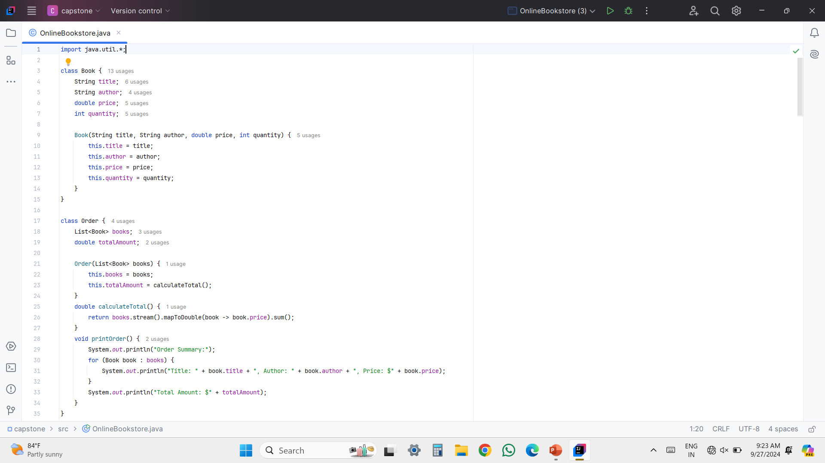
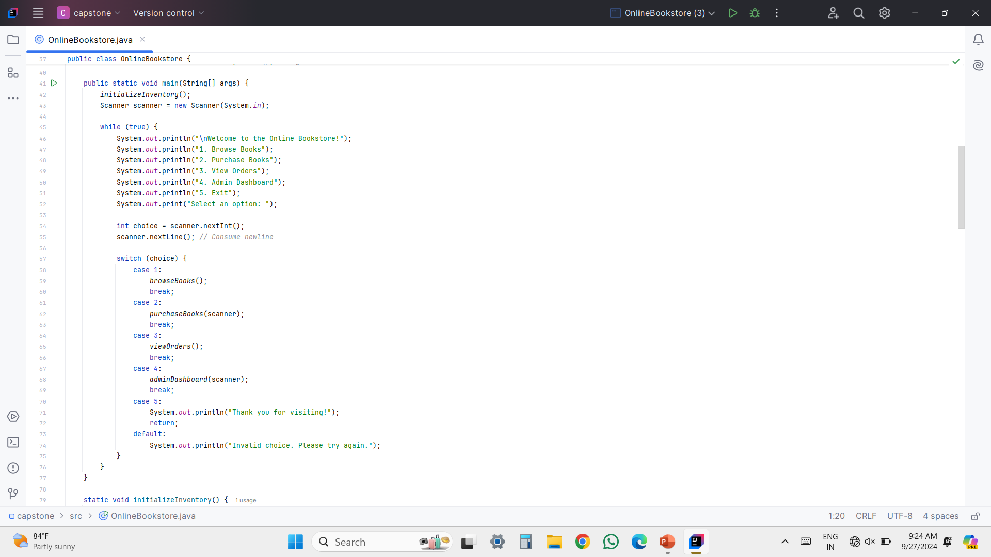
CODE IMPLEMENTATION(SCREENSHOT)

Slide 9
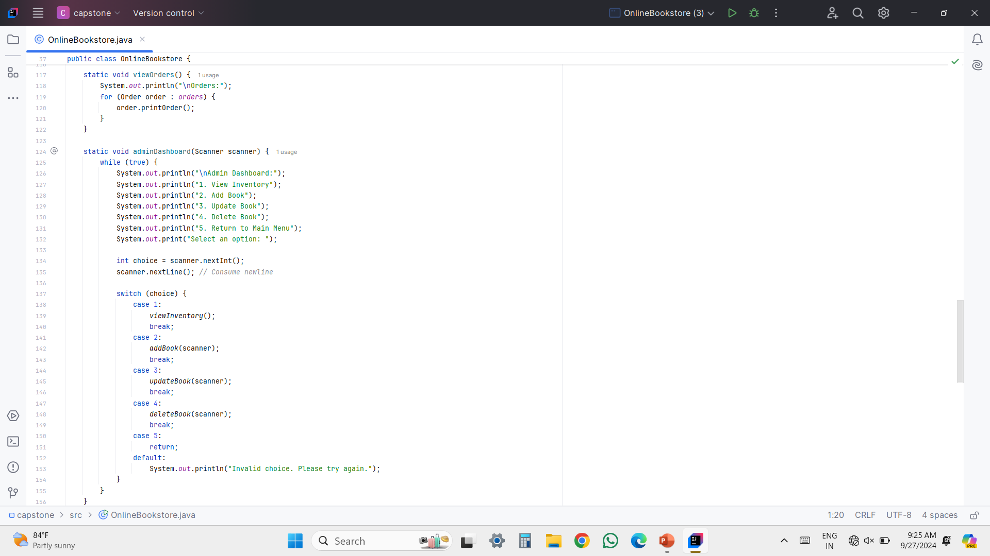
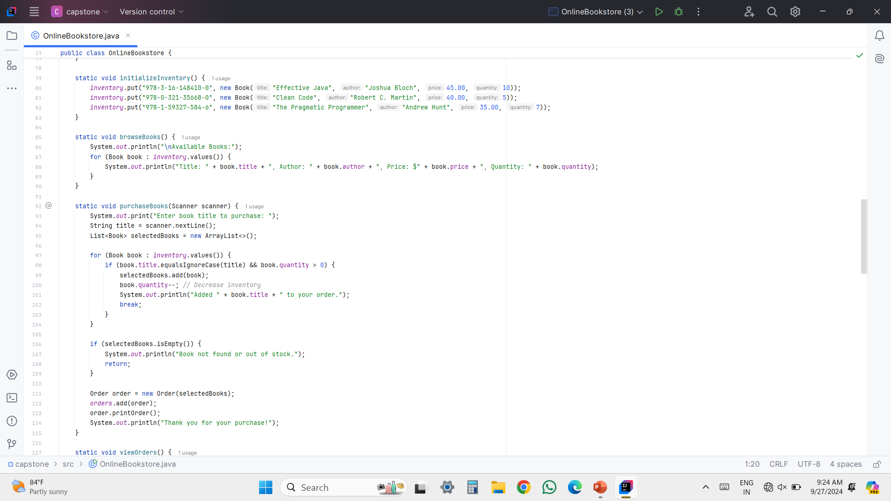

Slide 10
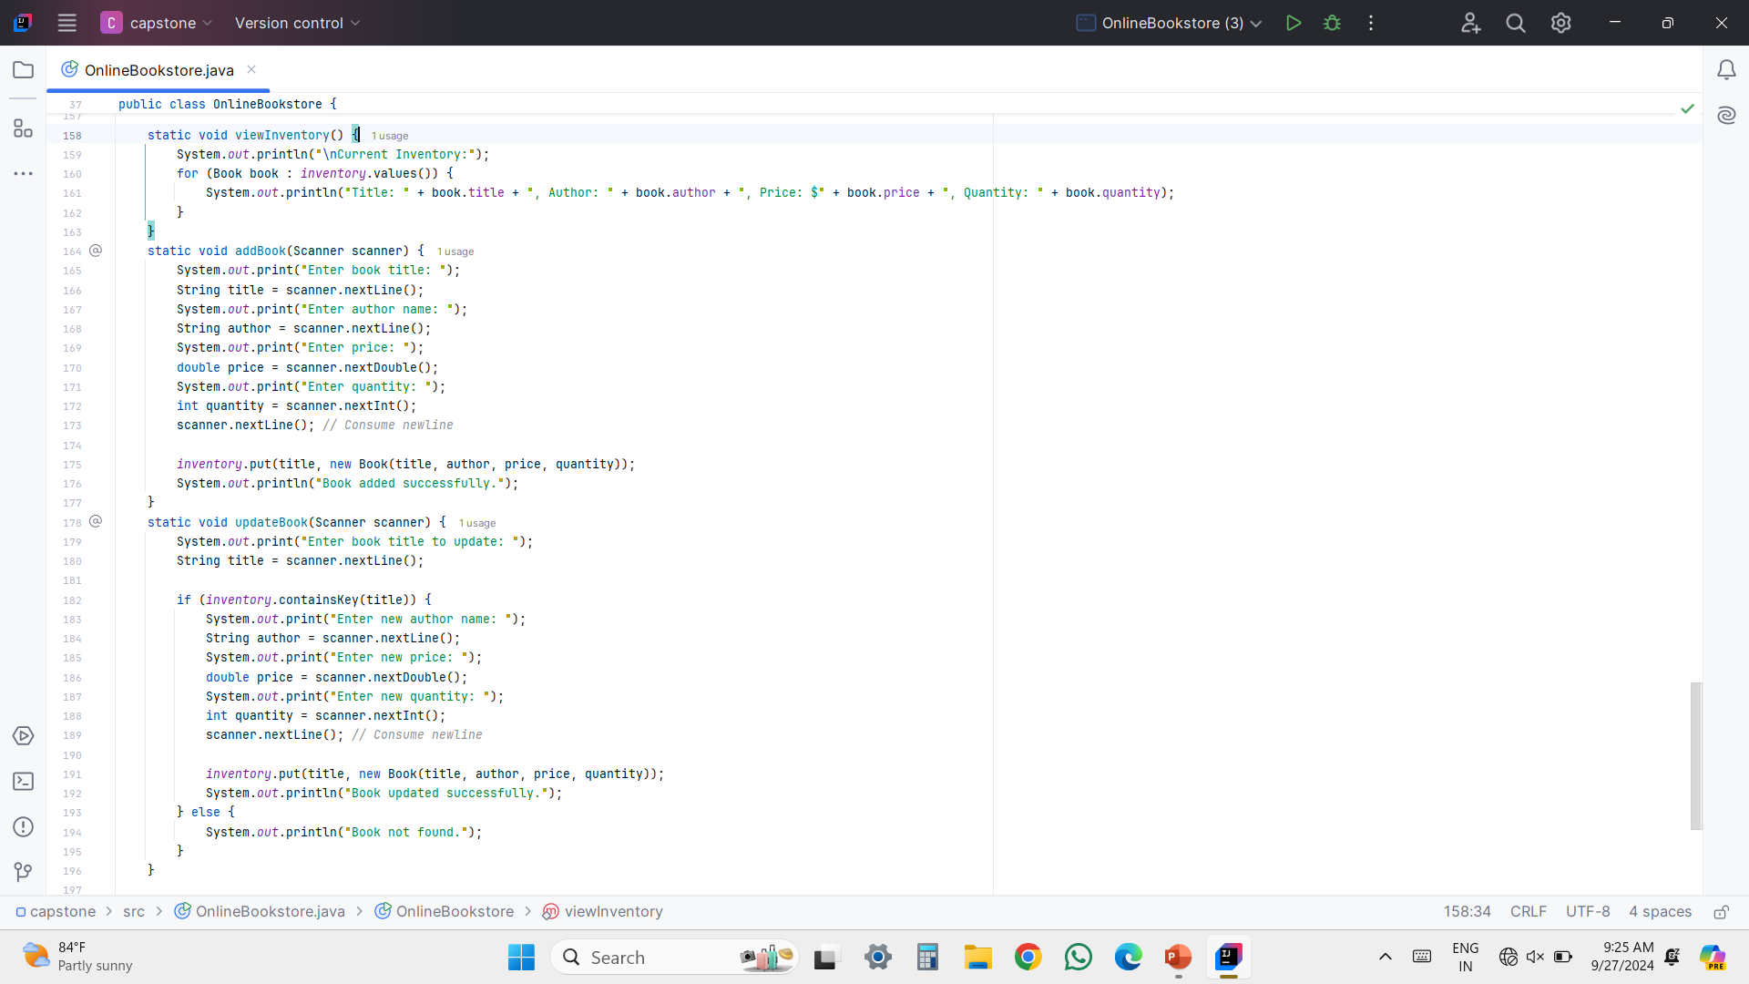
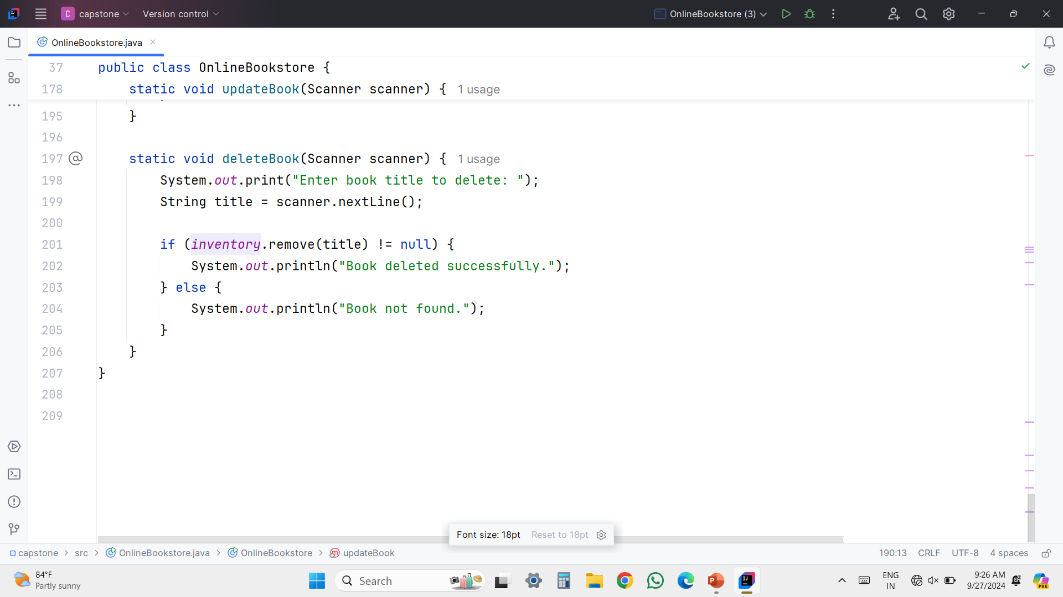

Slide 11
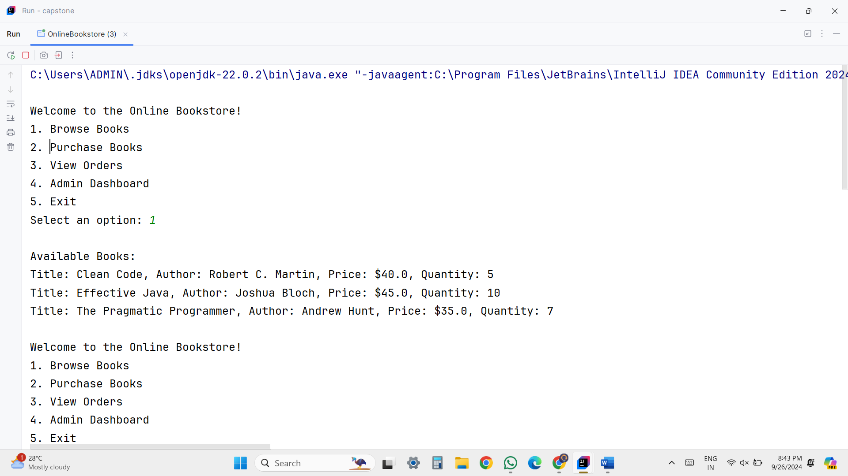
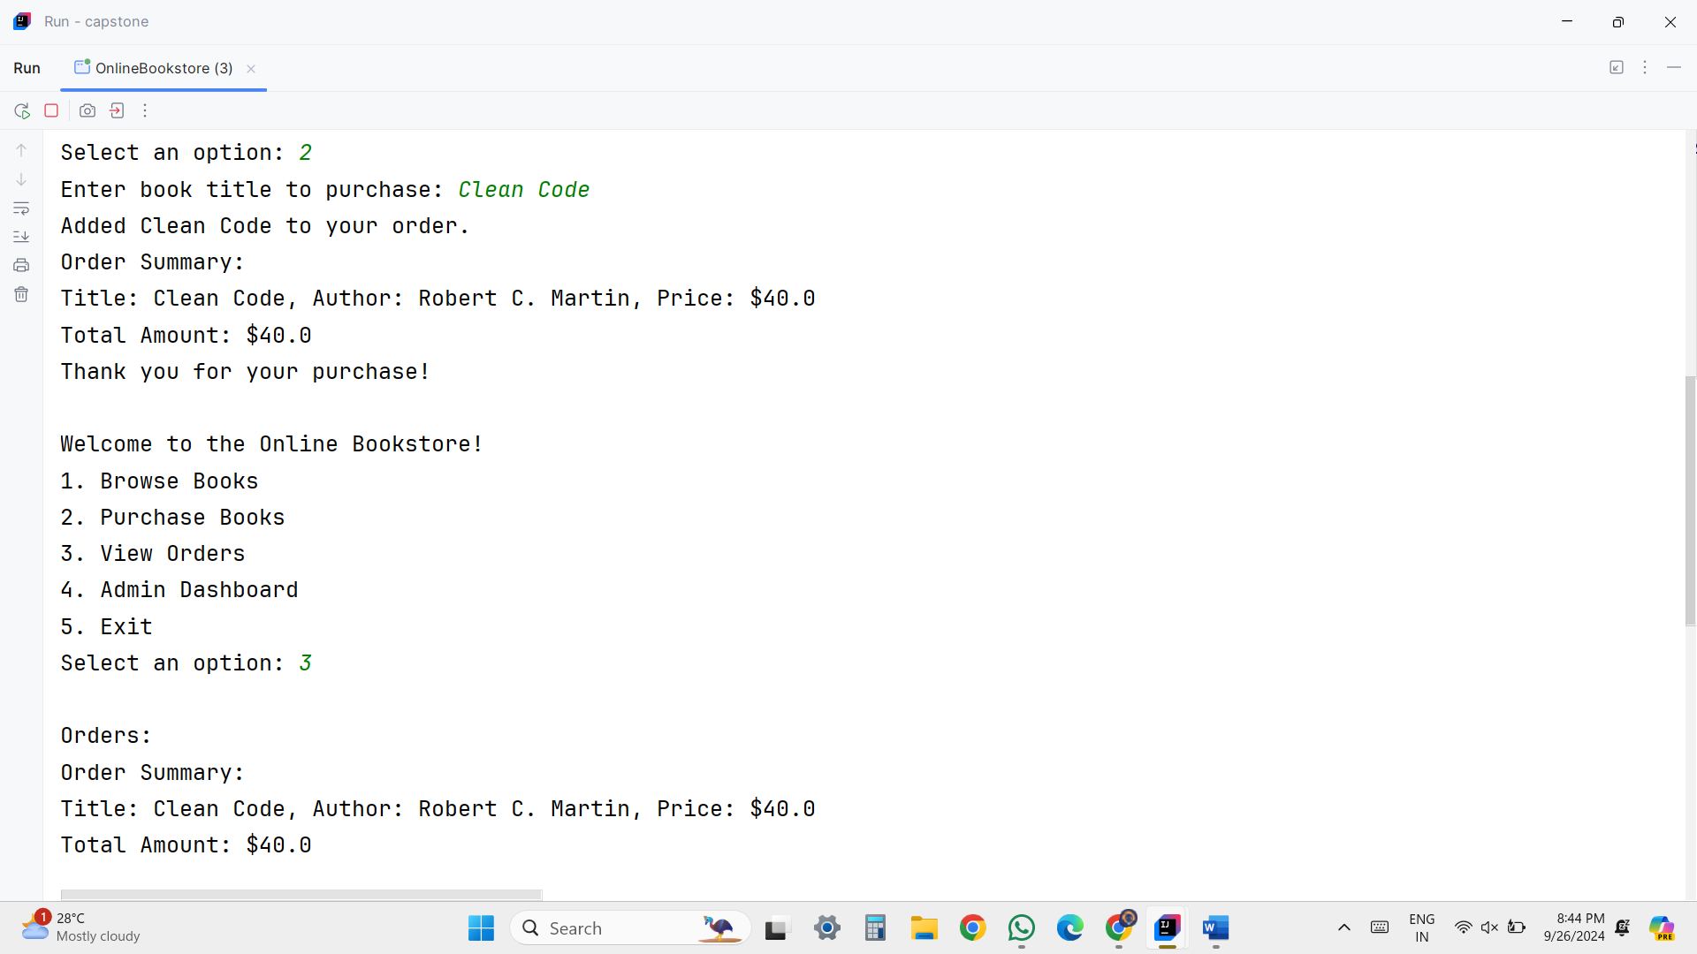
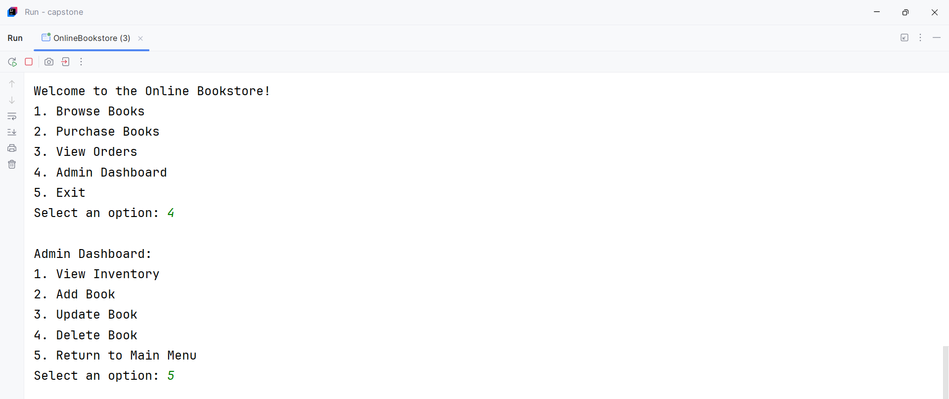
OUTPUT(SCREENSHOT)

Slide 12
EACH MODULE DESCRIPTION
Customer Interface:
  Enables customers to easily search for books by title, author, or genre.
  Features a shopping cart for adding and viewing selected books and their total cost, facilitating a streamlined purchasing process.
Admin Interface:
  Provides a comprehensive dashboard for admins to manage the bookstore's inventory.
  Admins can add new books, update existing entries, and delete items from the inventory.
  Includes order management features to view pending orders, process shipments, and update order statuses.
Database Management:
  Utilizes AWS RDS to store information securely, ensuring easy access and management of data related to books, customers, and orders.
  Implements CRUD (Create, Read, Update, Delete) operations to allow efficient management of inventory and customer information.

Slide 13
Order Processing:
  Contains backend logic for processing customer orders, including payment handling and order confirmations.
  Automatically sends email notifications to customers upon order placement and shipment.
Reporting Module:
  Allows the admin to generate sales reports based on various criteria, such as daily or monthly sales, providing insights into the bookstore's performance and inventory turnover.
User Authentication:
  Integrates AWS Cognito for secure user management, ensuring that customer credentials are protected and providing a seamless login experience.
Cloud Storage Integration:
  Uses AWS S3 for storing book cover images and other media content, ensuring fast and reliable access to media files without burdening the primary database.

Slide 14

        The Online Bookstore Management System offers a comprehensive solution that enhances the shopping experience for customers while providing robust tools for admins to manage operations efficiently.

Slide 15
Future Enhancements:
AI Integration: Implement AI-driven recommendations to suggest books based on user preferences and browsing history.
Mobile Application: Develop a mobile app to increase accessibility and reach a broader audience.
Advanced Security Features: Introduce multi-factor authentication to further secure user accounts.
Enhanced Reporting: Expand reporting capabilities to include detailed customer insights and sales trends for more informed decision-making.

Slide 16
References
[1] Amazon Web Services Documentation: https://aws.amazon.com/documentation/
[2] Java Programming Guide: https://docs.oracle.com/javase/tutorial/
[3] Spring Framework Documentation: https://spring.io/docs
[4] Web Application Security Best Practices: https://owasp.org/www-project-top-ten/
[5] UI/UX Design Principles: [Link to a relevant resource or book]

Slide 17
THANK YOU

